Slide 1
Predictive Modeling in R
R Training Part III

Slide 2
Roadmap
Session 1
Session 2
Session 3
Defining R
Dataframes
Basic Functions
Data Manipulation
Apply
Functions/Macros
Visualization
Classification
Time Series (Notes Only)

Slide 3
Today
Predictive Modeling Process
Classification in R
Logit
Decision Tree - rpart
Random Forest – randomForest
Time Series Forecasting
forecast package
Notes:
Are you more interested in learning about predictive modeling as a process or coding it in R? or both?

Slide 4
Predictive Modeling Process
Clear Problem Statement
Measure Performance
Acquire Data
Score Test Data
Cleanse Data
Train Model
Split Data

Slide 5
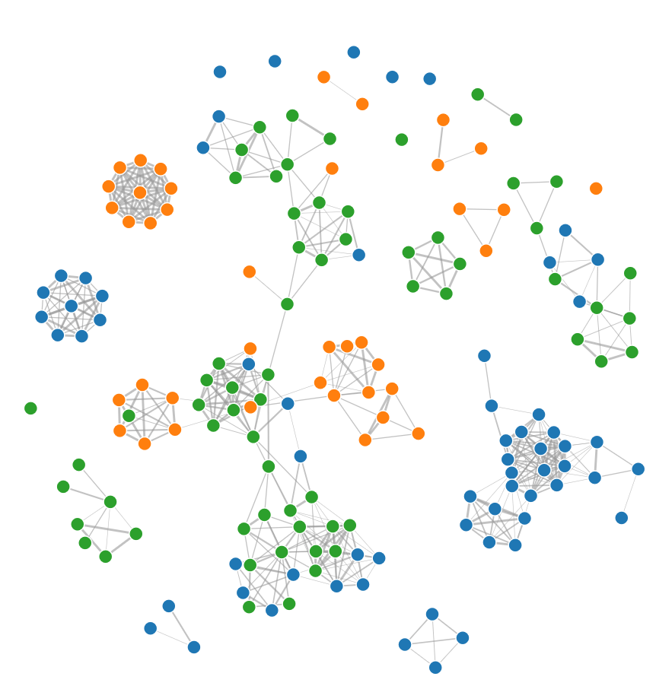
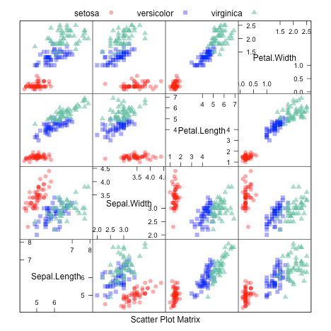
Predictive Modeling Process
Regression
CART
RandomForests
Support Vector Machine
Neural Network
K-Nearest Neighbour
Naïve Bayesian
Classification and Regression Training
Caret unifies over a few hundred R packages including
Makes training and model evaluation easier
Allows advanced tools like k-fold cross validation or bootstrapped models

Slide 6
Defining the Problem
Clear Problem Statement
Measure Performance
Acquire Data
Score Test Data
Cleanse Data
Train Model
Split Data
Questions | Marketing Example
What’s the business challenge? (Is it action oriented or knowledge oriented) | We are losing customers and want to be able to know what we should do; we want to know the possible drivers and take action
How would you define that with your available data? | There is no contract, customers can leave whenever; they pay a monthly fixed cost – termination of service
How will the business action this? | We want to reach out to customers via email to try and ‘save them’
When is the right time to act? | We need to get out in front of this – ideally we want to know cx that may leave 2 months from now (skip months)
Notes:
STRAW POLL: How easy do you think this step is?

Slide 7
Skip Windows
Clear Problem Statement
Measure Performance
Acquire Data
Score Test Data
Cleanse Data
Skip windows are important to allow time to react before an event.
Train Model
Split Data
Period to Gather Data
Skip
Event
User 1
Period to Gather Data
Skip
Event
User 2
Period to Gather Data
Skip
Event
Period to Gather Data
Skip
Event
User 3

Slide 8
Acquire & Cleanse Data
Clear Problem Statement
Measure Performance
Acquire Data
Score Test Data
Cleanse Data
Acquire Data
Internal
3rd Party Data – demographics/psychographics
Open Data – Wikipedia, maps, census, etc.
Cleansing / Feature Engineering
“Outliers”
Missing Data
Binning Continuous
Addressing Highly Sparse Data
Variable Reduction
Train Model
Split Data
Notes:
b

Slide 9
Feature Engineering
Clear Problem Statement
Measure Performance
Acquire Data
Score Test Data
Cleanse Data
At BlackBerry, we build data mining snapshots for every user….
Each contained 3000+ variables for a single BlackBerry customer! The process to create these variables is sometimes referred to as Feature Engineering. Domain knowledge can be especially useful here.
Take a single variable, think about how you can derive other variables from it?
Date User Acquired
Products Purchased from Best Buy
Dollars Spent by Month
Take a combination of variables, think about how you may want to combine them together?
BMI+AGE in Life Insurance
Sometimes taking an entity and breaking it down can be very useful
Job Posted on LinkedIn
Train Model
Split Data
Notes:
Date User Acquired – Weekday, Days Since Acquisition/Tenure, Binned Tenure, Month, Season, etc.
Products Purchased from Best Buy – Size of Cart, % of Promo Items, Categories Shopped, Premium/Discount Mix, New vs. Older Products, Depth/Bredth of Basket, Total Spend

Slide 10
Model Snapshots
If you want to build models at any scale, you need to think about automating feature extraction.
Books
Level 1: Monthly Snapshots
Level 2: Functions
get_features(UserID, Date)
Mar
Apr
Purchases
 | Pur_12M | Pur_6M
User 1
User 2
User 3
…
May
Digital Activity

Slide 11
Split Data
Clear Problem Statement
Measure Performance
Acquire Data
Score Test Data
Cleanse Data
Train Model
Split Data
Labeled Data
Holdout Method – Split your labeled data into training and validation , often 80/20
Training
Validation
http://sebastianraschka.com/blog/2016/model-evaluation-selection-part3.html

Slide 12
Clear Problem Statement
Split Data
Measure Performance
Acquire Data
Score Test Data
Cleanse Data
Train Model
Split Data
#Create ID as a column since most datasets you deal with will have them
spam <- cbind (rownames (spam), spam)
colnames (spam)[1] <- "ID"
#Split data set between test and training
data (spam)
TRAIN_ID <- sample (spam$ID, nrow (spam)*.8)
TEST_ID <- spam$ID [!(spam$ID %in% TRAIN_ID)]
train <- spam [spam$ID %in% TRAIN_ID,]
test <- spam [spam$ID %in% TEST_ID,]

Slide 13
Train and Score
Clear Problem Statement
Measure Performance
Acquire Data
Score Test Data
Cleanse Data
Labeled Data
Train Model
Split Data
Training
Validation
ML Algorithm
Model
Scores
http://sebastianraschka.com/blog/2016/model-evaluation-selection-part3.html

Slide 14
Clear Problem Statement
Train
Measure Performance
Acquire Data
train (formula, data, method, parameters)
Score Test Data
Cleanse Data
❶
❷
❸
❹
Train Model
Split Data
❶ Y~ X1+X2 or Y~.
library (caret)
#Train a logit model
mod_glm <- train (type~., data = train[,!(colnames (train) %in% "ID")], method = "glm", family = "binomial")
❷ data = spam
❸ method = model
❹ specific to each model
Model | Method Name
Decision Tree | rpart
Random Forest | rf
Logit | glm, family = “binomial”
Naïve Bayes | nb

Slide 15
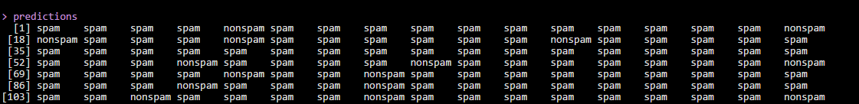
Clear Problem Statement
Score
Measure Performance
Acquire Data
Score Test Data
Cleanse Data
predict (model, newdata)
Train Model
Split Data
❶
❷
❶ model object
predictions <- predict (mod_glm, test)
predictions
❷ newdata

Slide 16

Measure Performance
Clear Problem Statement
Measure Performance
Acquire Data
Score Test Data
Cleanse Data
Train Model
Split Data
Many ways to measure ‘performance’ – you need to know your business problem.
Accuracy – Share of correctly classified observations
Precision (Positive pred value) –How accurate are we in positive predictions?
Recall (Sensitivity) – What % of the actual positives can we accurately predict?
F1 Score – The harmonic mean between Recall & Precision
http://machinelearningmastery.com/classification-accuracy-is-not-enough-more-performance-measures-you-can-use/

Slide 17
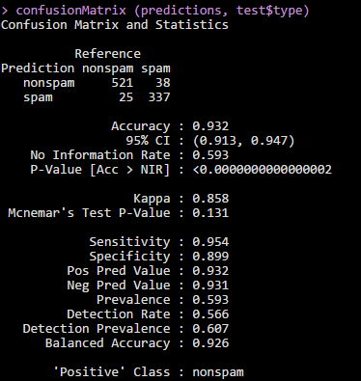
Measure Performance
Clear Problem Statement
Measure Performance
Acquire Data
Score Test Data
Cleanse Data
confusionMatrix (predicted labels, actual labels, positive class)
Train Model
Split Data
❶
❷
❸
❶ predicted labels
❷ actual labels
❸ positive class defined
❶
❷
confusionMatrix (predictions,
test$type, positive = “spam”)
❸
❹

Slide 18
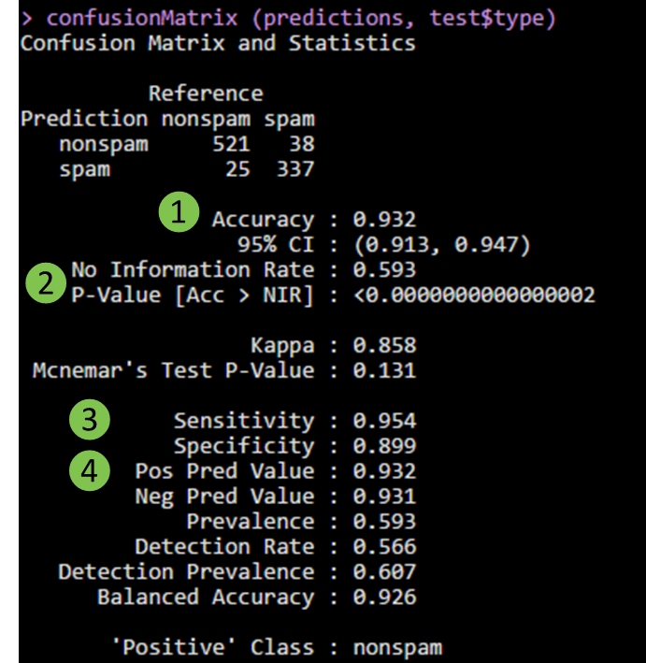
Understanding Output
❶ (TP + TN) / Total
❷ A model contains only positive or negative is the no information rate. If we guess everything is not spam, we’d be right 59.3% of the time.
❸ Recall – what % of TP can we find?
❹ When we guess positive, how accurate are we?
Generally, models with high recall and high precision make useful models.

Slide 19
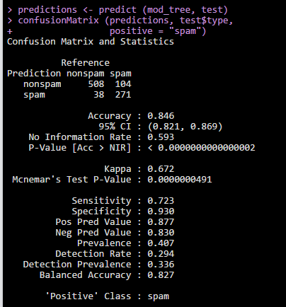
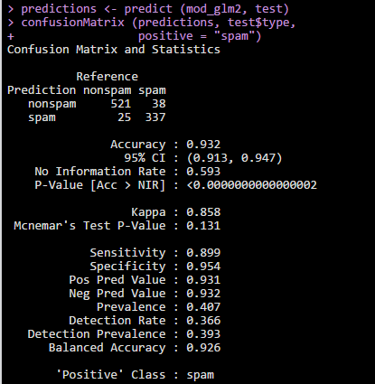
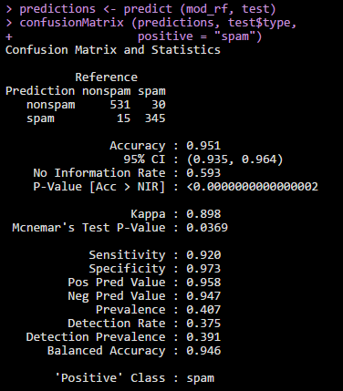
Compare Various Models
Pick the ‘best’ model but if it’s close choose simplicity and explainability.
Easiest to Understand
Winning Model

Slide 20
Time Series

Slide 21
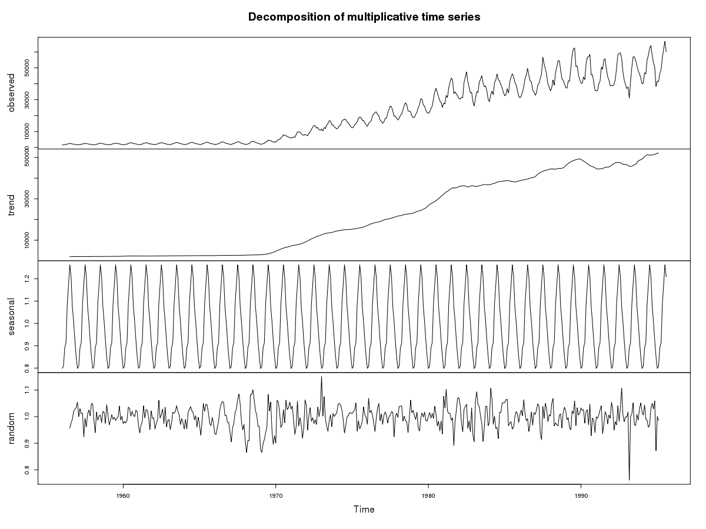
Time Series Forecasting
Time Series Forecasting is focused on predicting future values based on previously observed prior values.
We won’t cover the theory but it’s in your econometrics textbooks. Look for Exponential Smoothing, ARIMA, Holt Winters, etc..
https://anomaly.io/seasonal-trend-decomposition-in-r/

Slide 22
Components of Time Series
raw data
❶ trend
❷ seasonal fluctuations
❸ ‘noise’

Slide 23
forecast package
Unsurprisingly, there’s a great R package to cover
Runs several different types of models to find the one with the best performance (highest accuracy) and provides a forecast for future periods
Can do the common time series forecasting models
library (forecast)
#Function to turn data into a time series
ts_data <- ts (data, frequency = 12)
data(gas)
decompose_gas <- decompose(gas, “multiplicative")
#The plot from the prior screen
plot(decompose_gas)

Slide 24
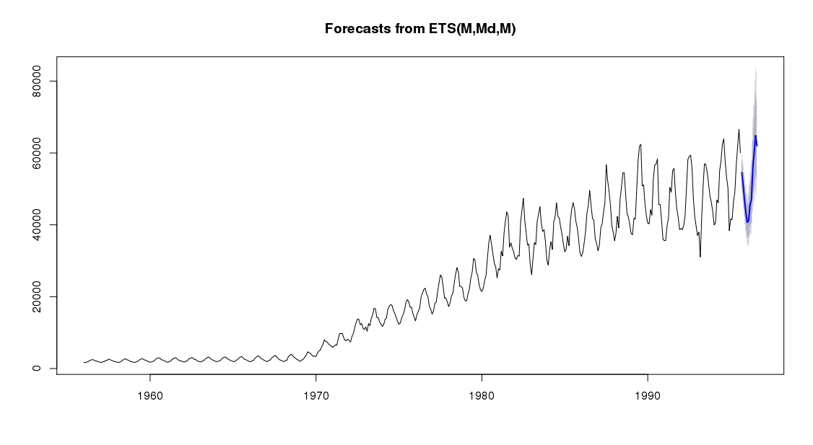
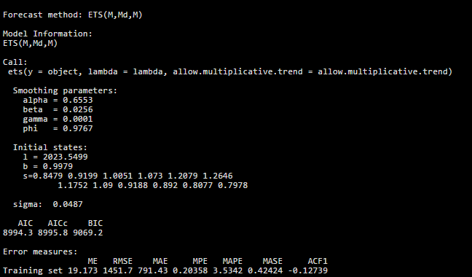
forecast package
Unsurprisingly, there’s a great R package to cover
f <- forecast (gas, h = 12, allow.multiplicative.trend = TRUE)
f
plot (f)
summary (f)

Slide 25
forecast package
The plot function shows the historical, predicted data and the confidence intervals.

Slide 26
forecast package
Summary produces all the details about the model selected by the forecast function including the seasonality, error measures, model specifications

Slide 27
Workshop

Slide 28
Workshop – 20 minutes
Install the caret package
Load the data GermanCredit
You need to build a model to predict whether someone will pay back a loan. It is pretty clean but you may still choose to create some variables.
Split your data set
Build 2 models - your choice what type
Score your model
Measure the performance of the model, what do you prefer? Why?
Notes:
Do you want to do this as a live coding exercise or break into small teams?

